Slide 1
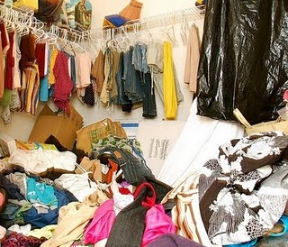
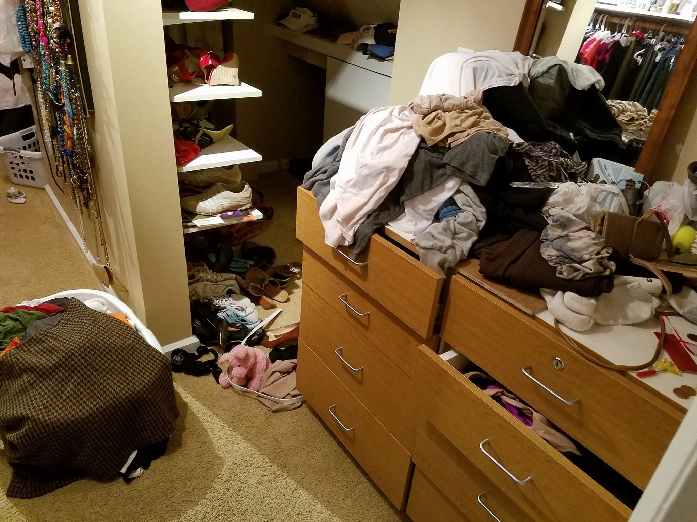
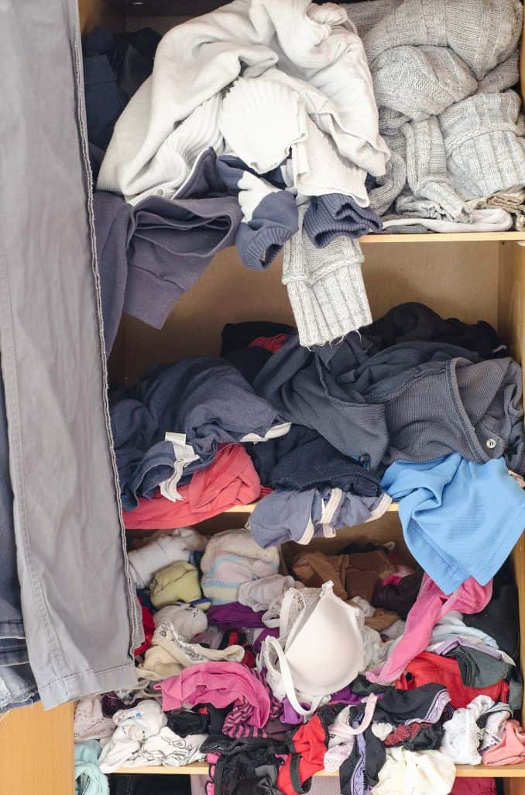
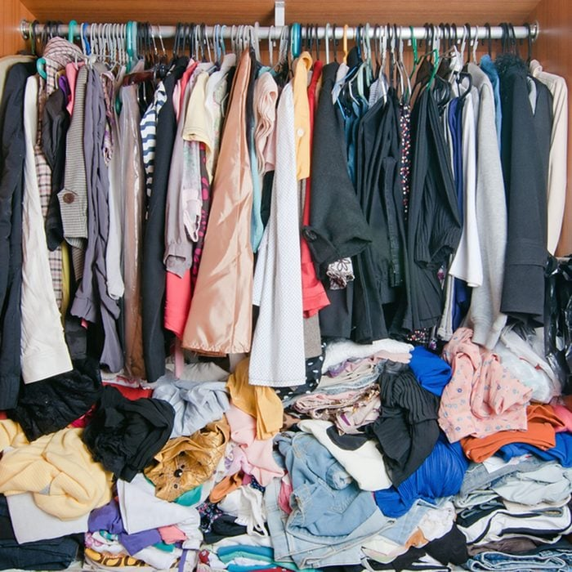
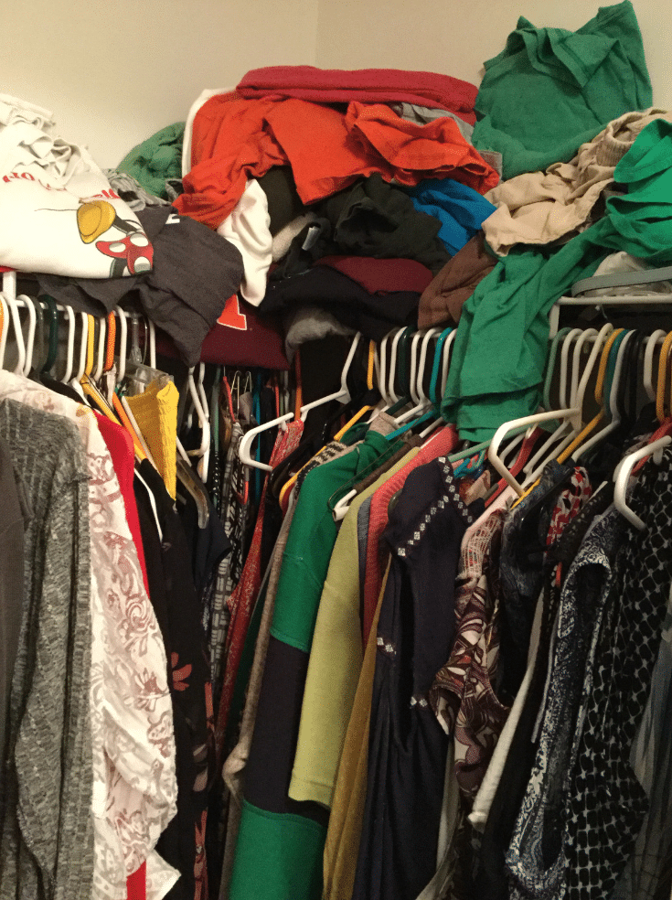

Slide 2
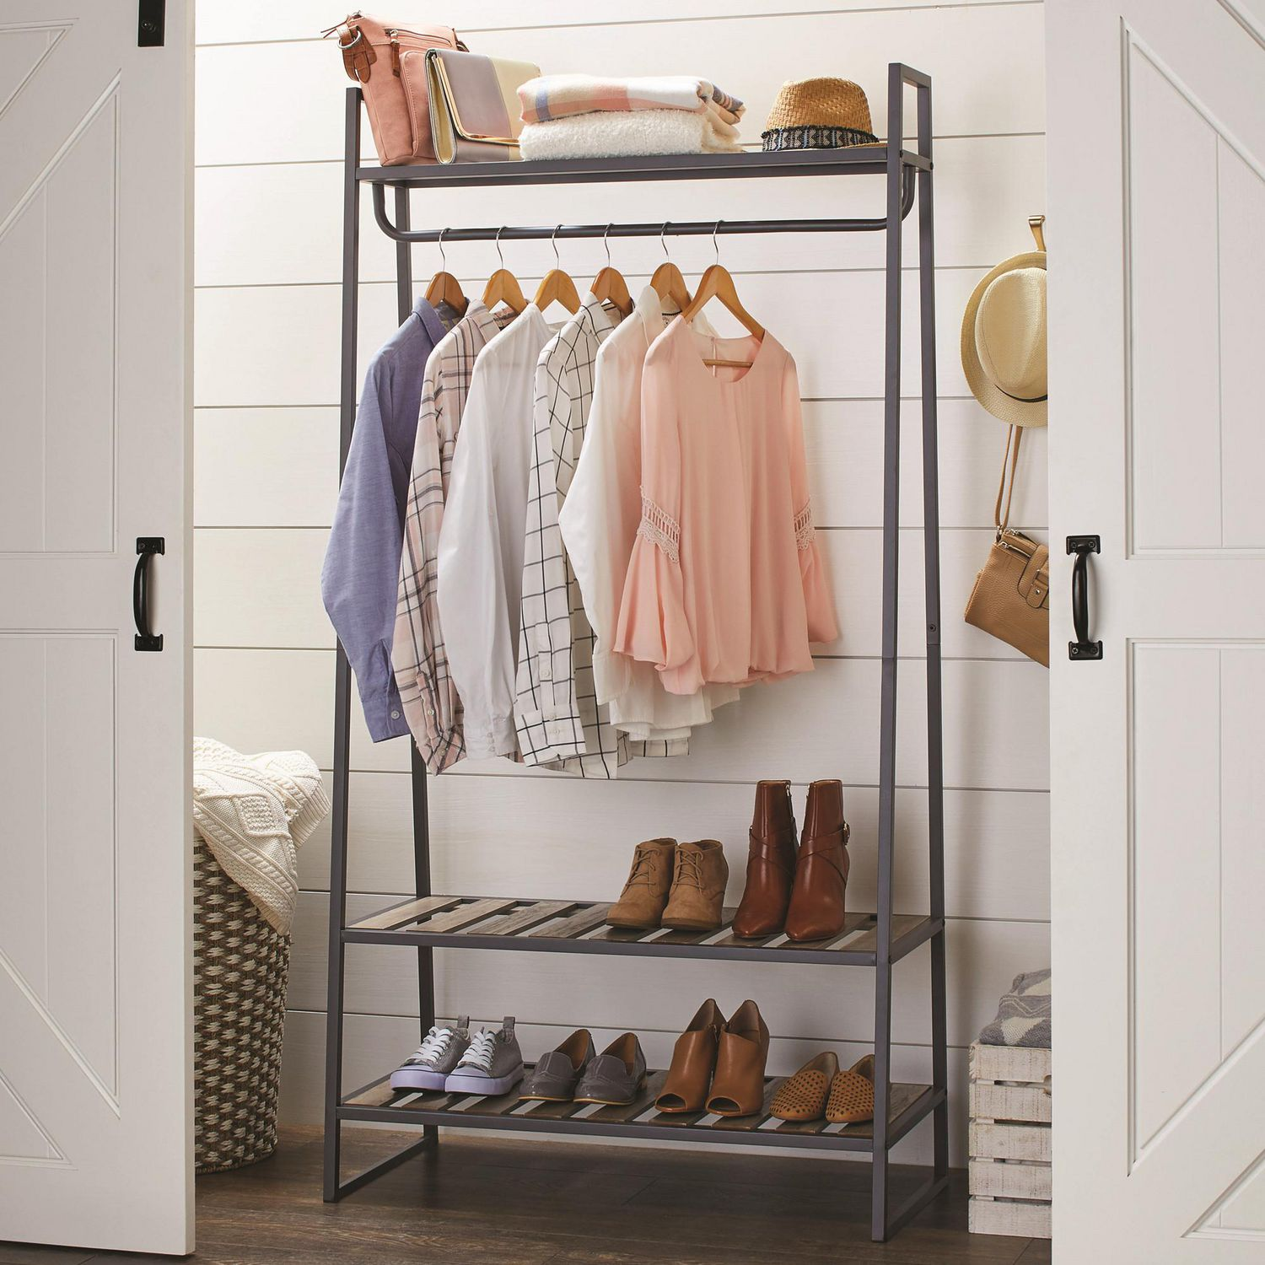
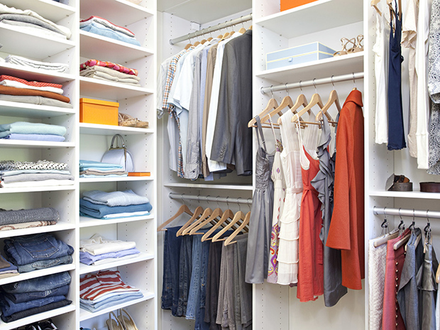

Slide 3
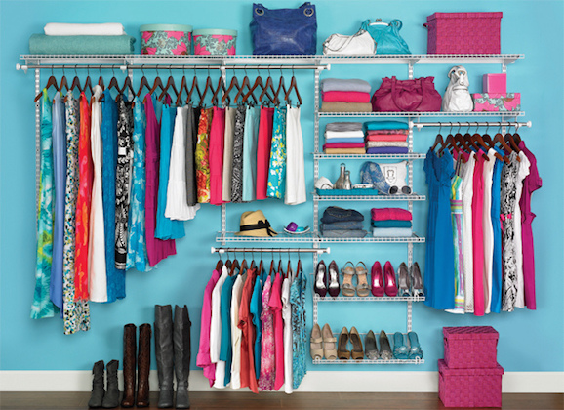

Slide 4
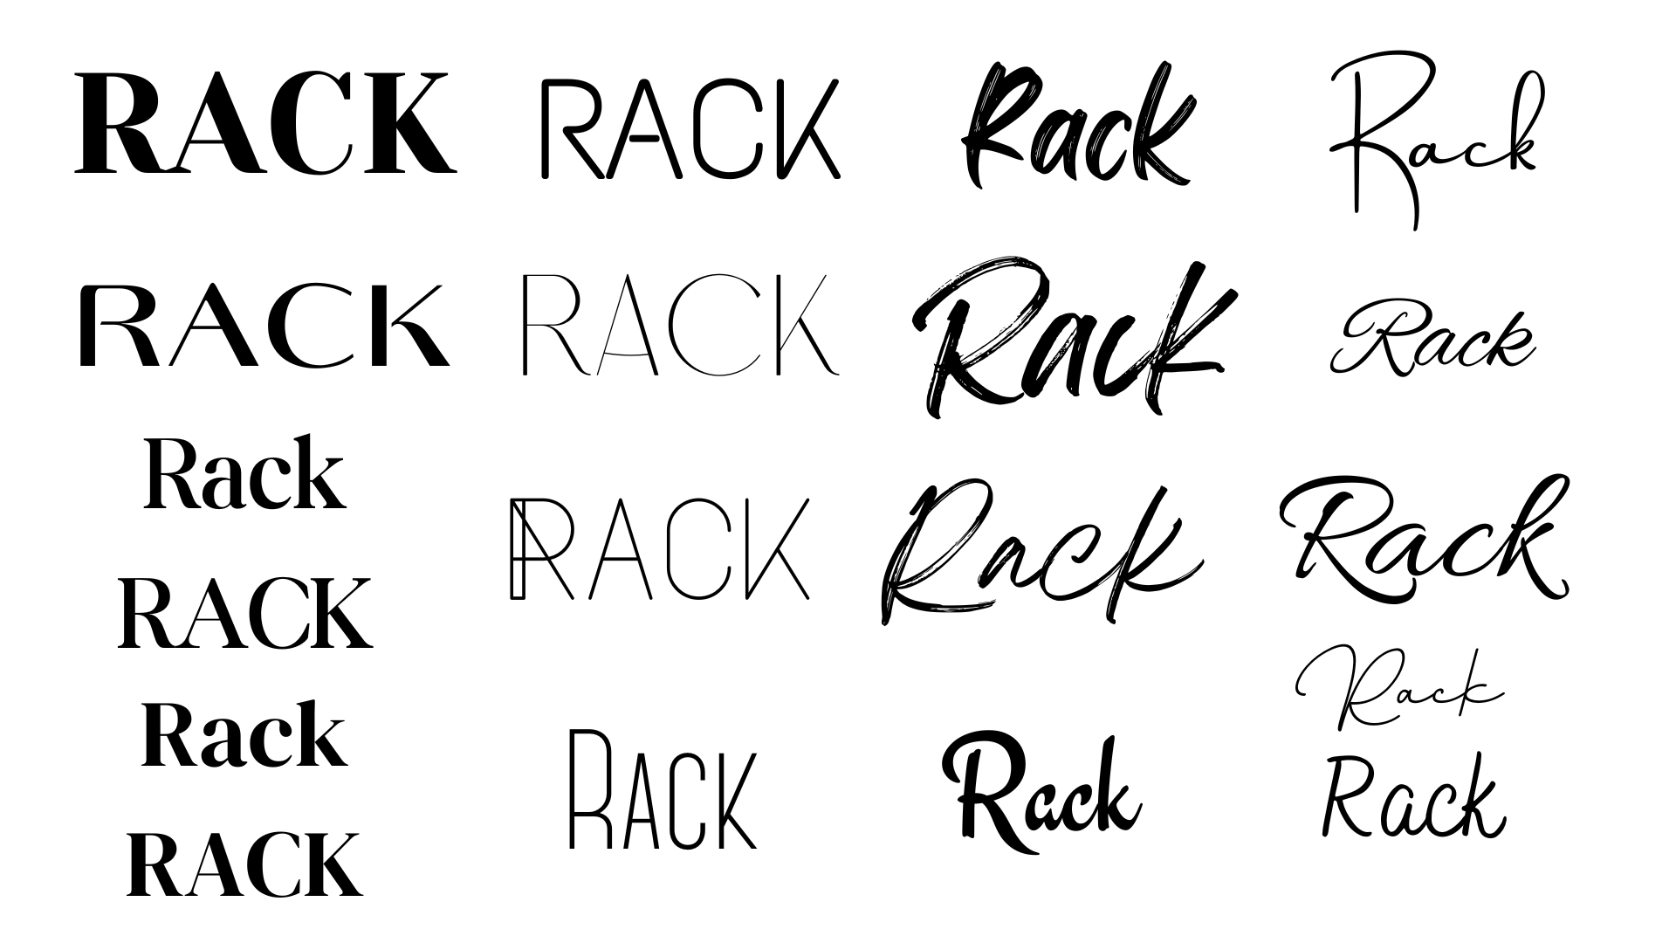

Slide 5
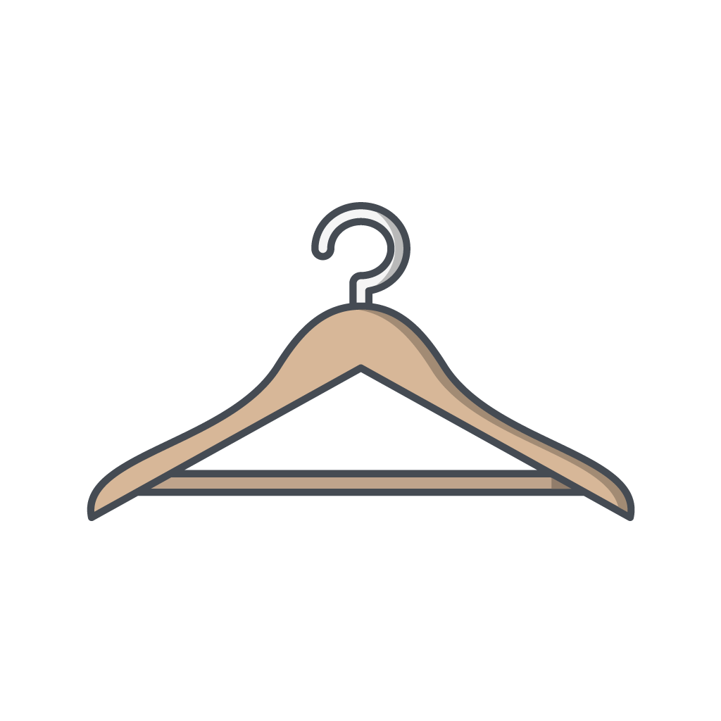
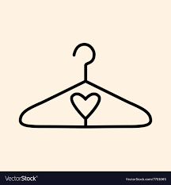
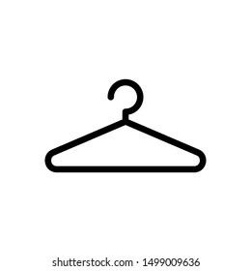

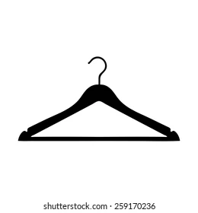

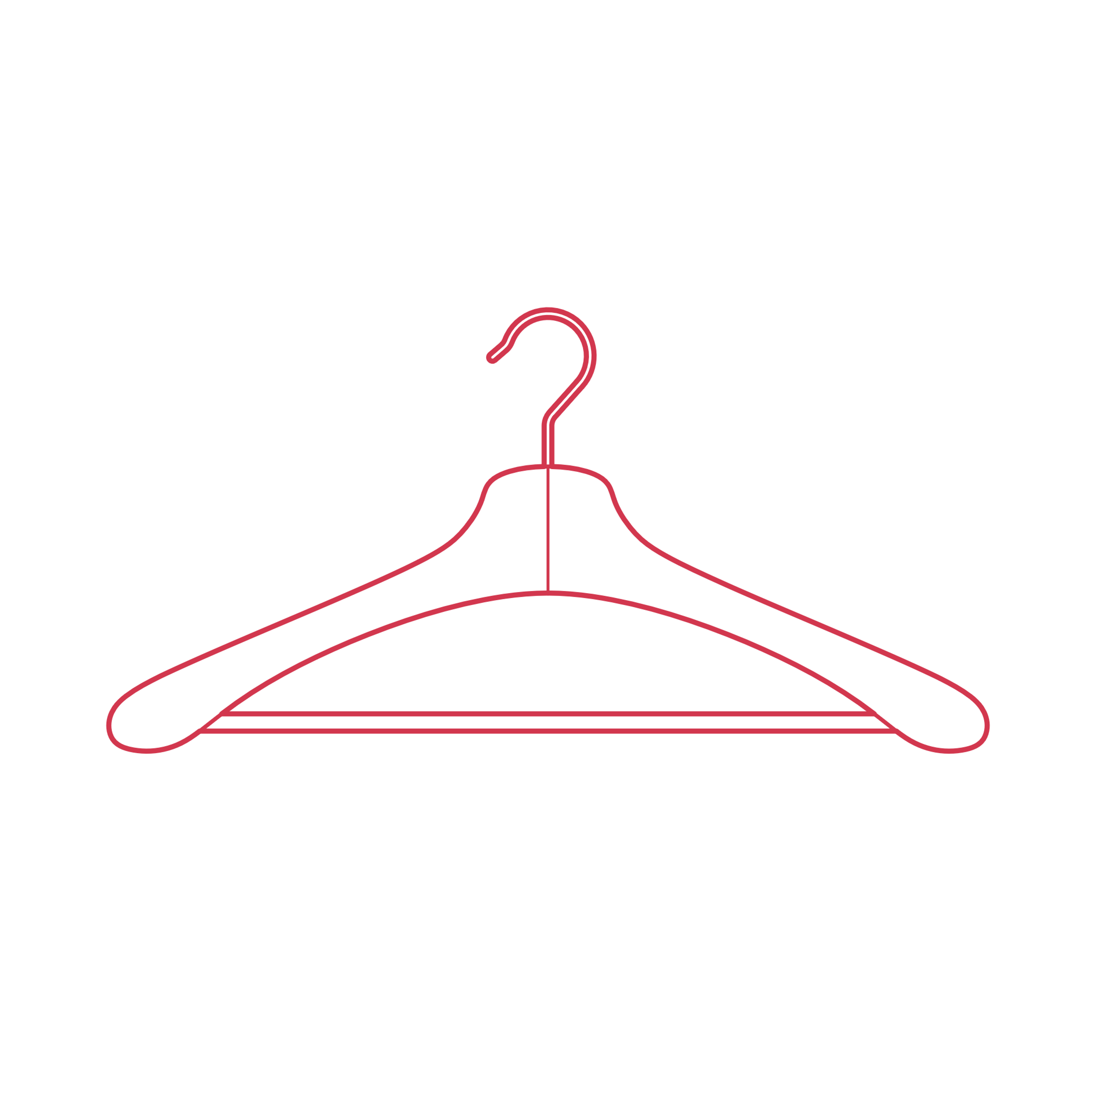
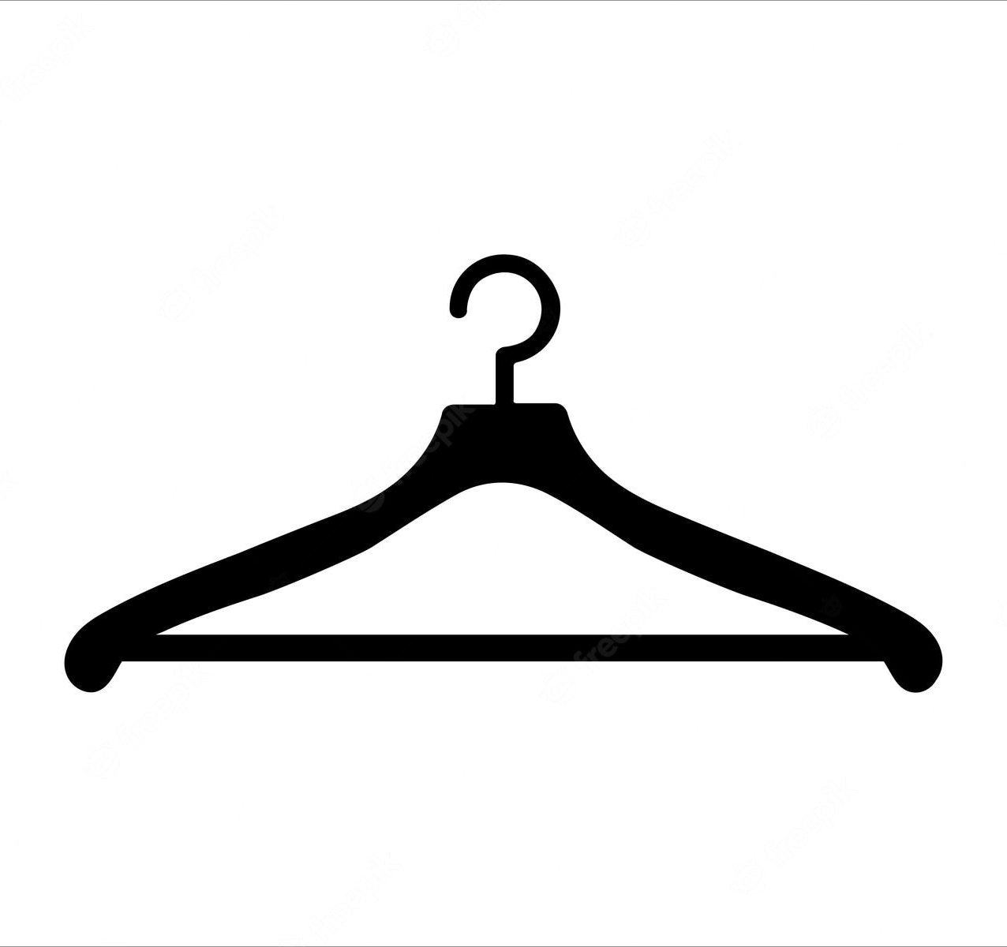
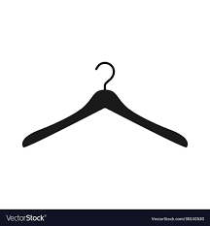

Slide 6


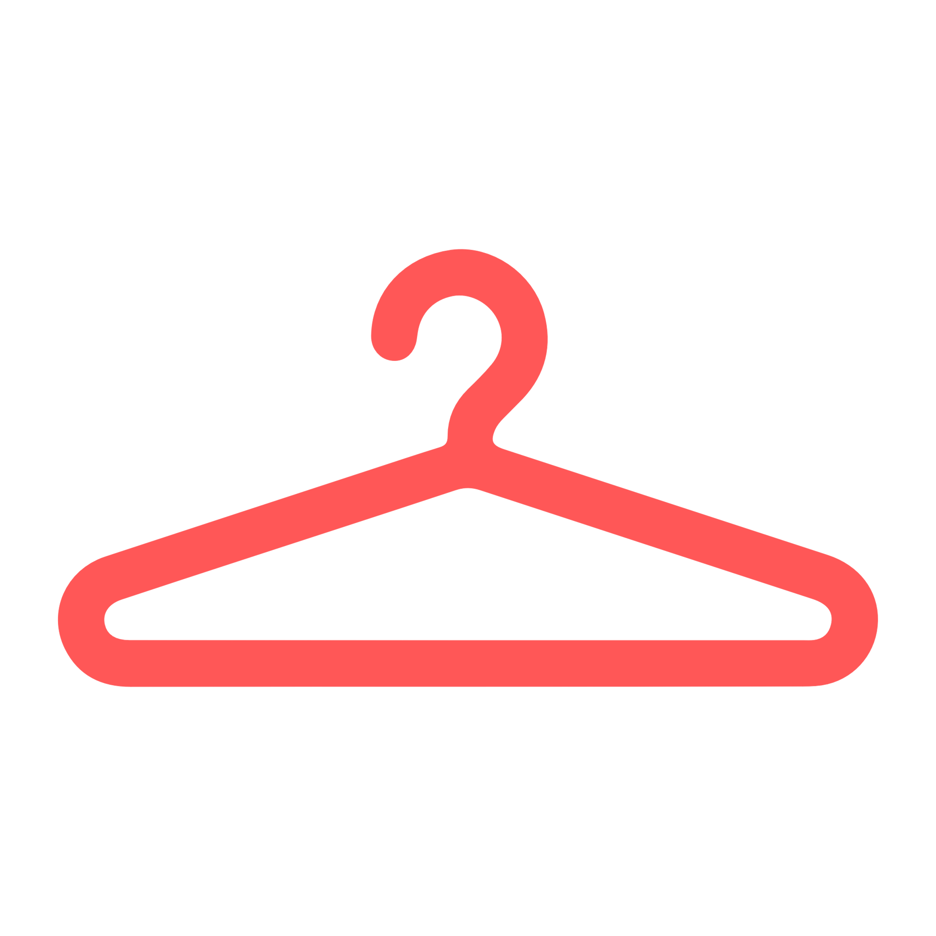
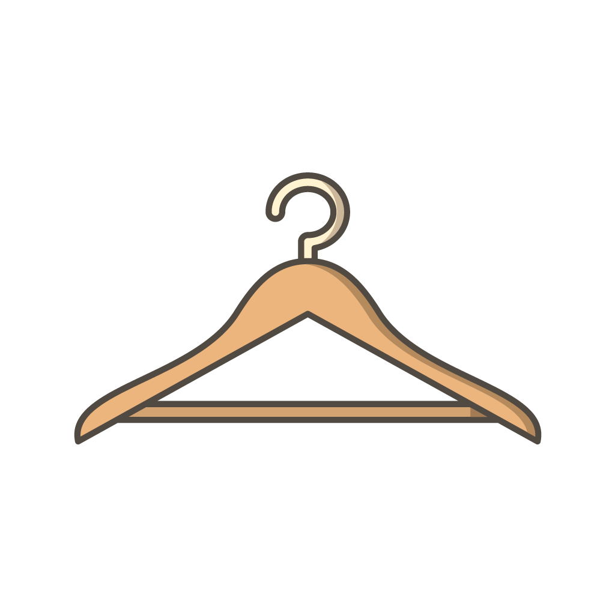
Rack
Rack
Brand Logo
Mobile App Icons
#FF5757 Coral Red
Scrapped App Icons
SAVE: Original Logo Layout

Slide 7
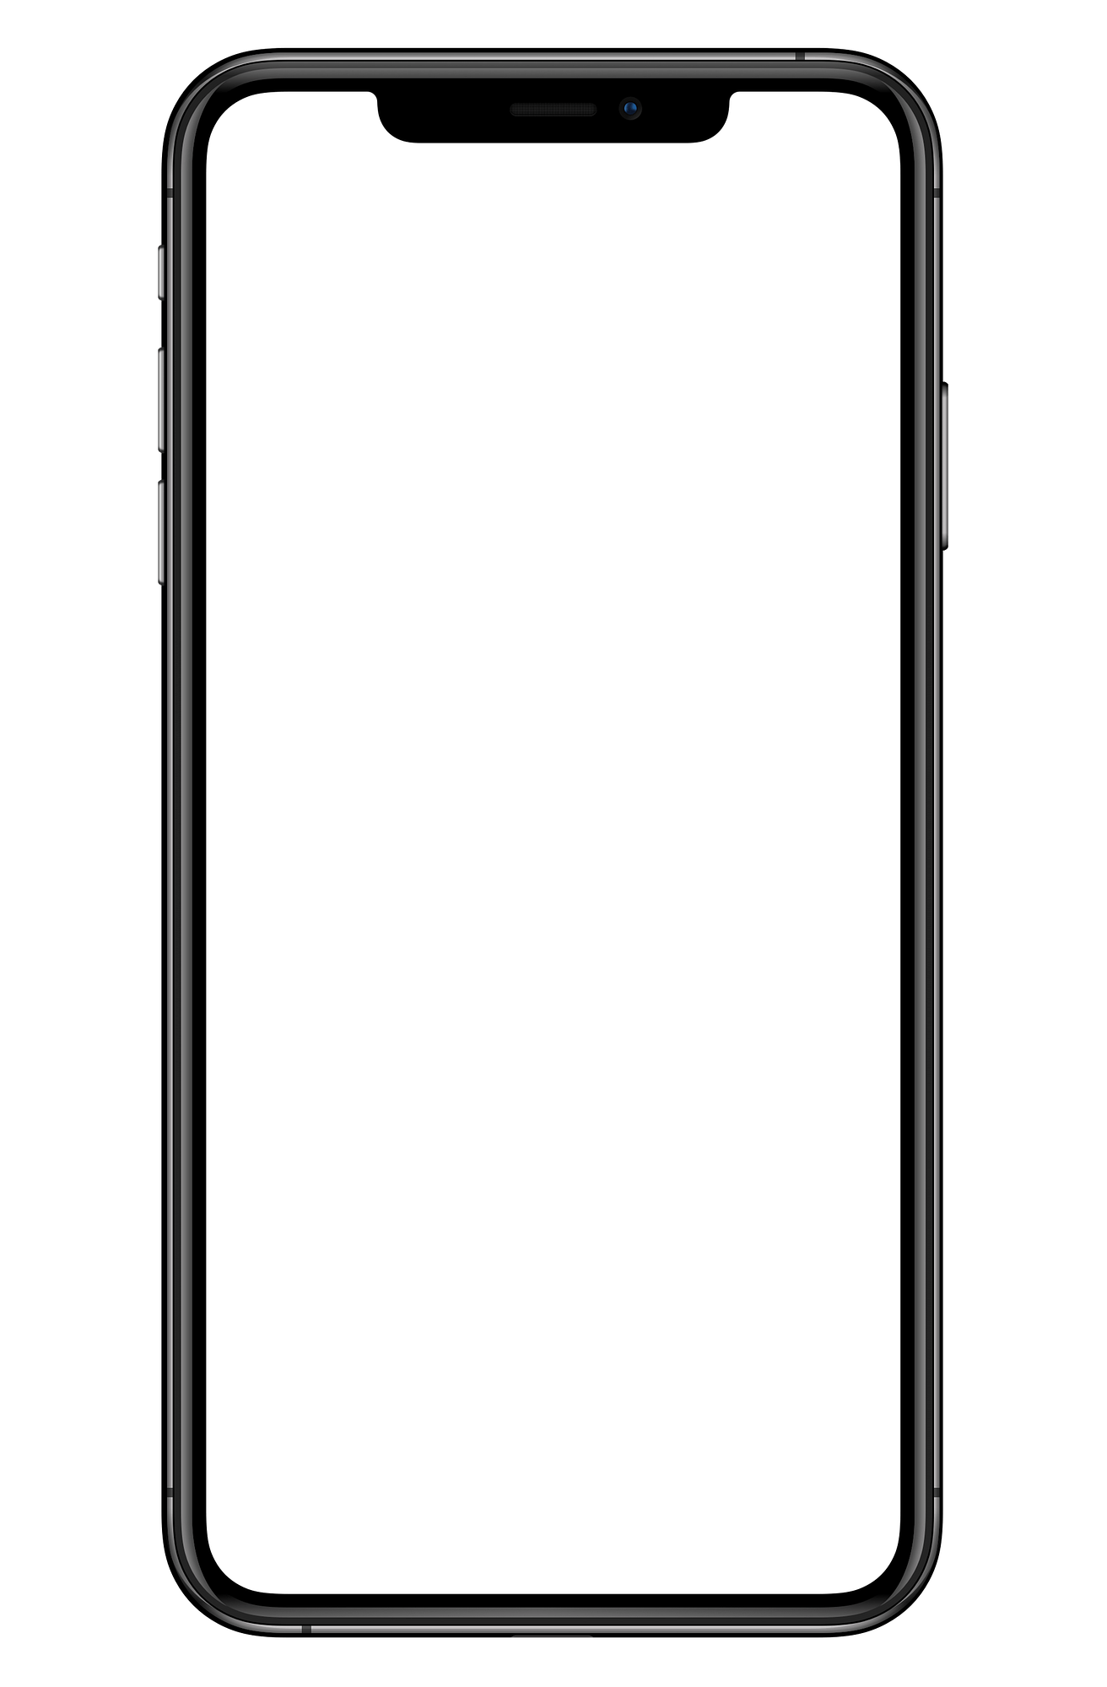




8:42
8:42
8:42
Later
Done
Sign Up
(its free!)
What’s in your closet?
What’s on your…
What’s in your closet?
What’s on your…
First Name
Last Name
Email
Log In
Password
Log In
Confirm Password
Email
Sign Up
Password
Let’s Go!
Let’s Go!
Modal to display the form
Already have an account? Log In!
Don’t have an account? Sign Up!
Powered by Paula Anderson
Powered by Paula Anderson
Powered by Paula Anderson

Slide 8

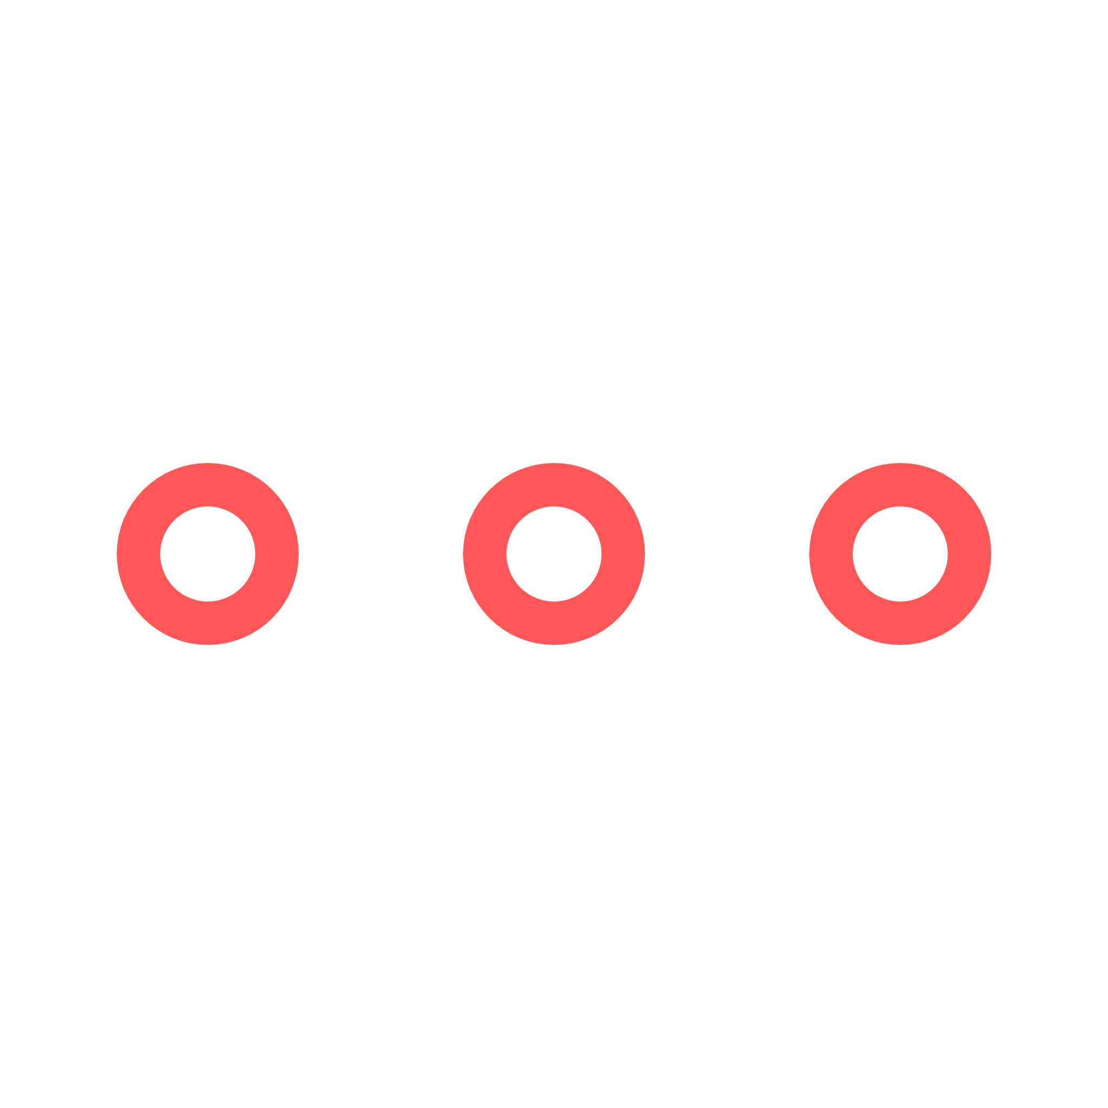

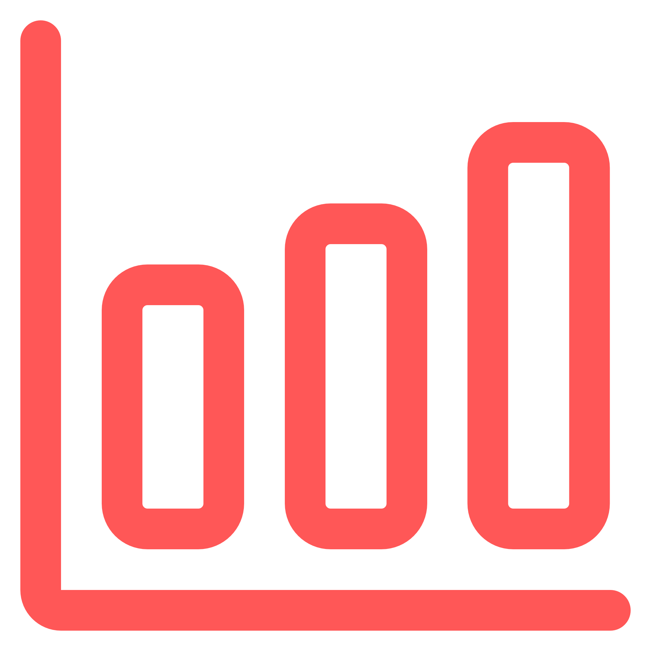


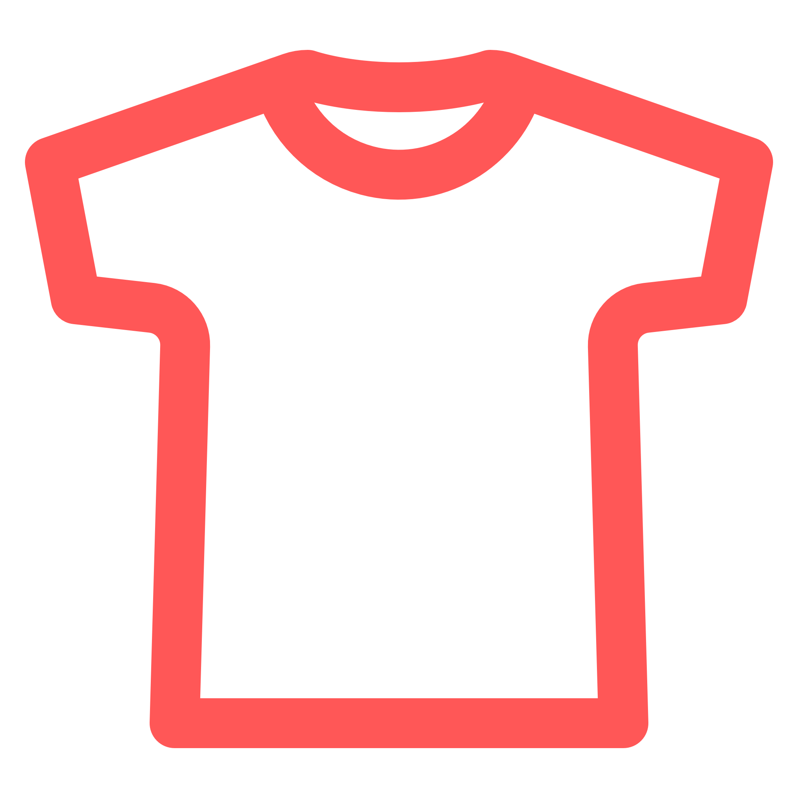
8:42
8:42
8:42
{{ FirstName }}, your latest Rack Stats await!
Good {{ TimeOfDay }}, {{ FirstName }}!
User Profile
Quick Rack: Opens camera and adds image to “Add New Rack” Form
App Settings
Another day, another outfit!
{{ Season }} clothes are your largest Rack category!
Home:
Planet icon instead of house for fresh modern vibe
Outfit Builder
Coming Soon!
User’s Closet Inventory
You have more
{{ GreaterType }} than
{{ LesserType }}!
Rack
Stats
My Wish Rack
Home
My Rack
Build
Home
My Rack
Build
Home
My Rack
Build

Slide 9





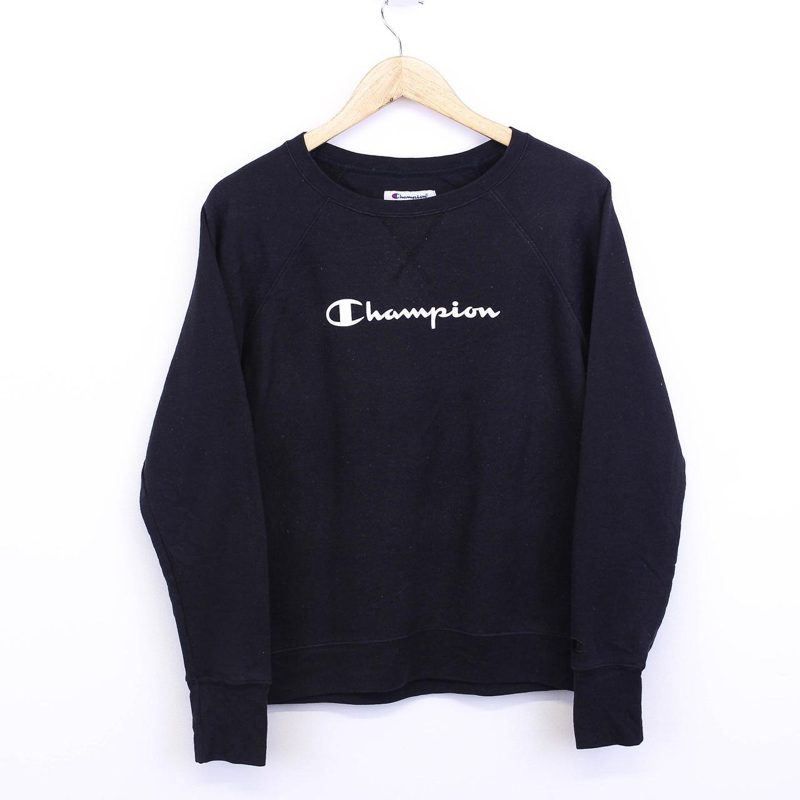
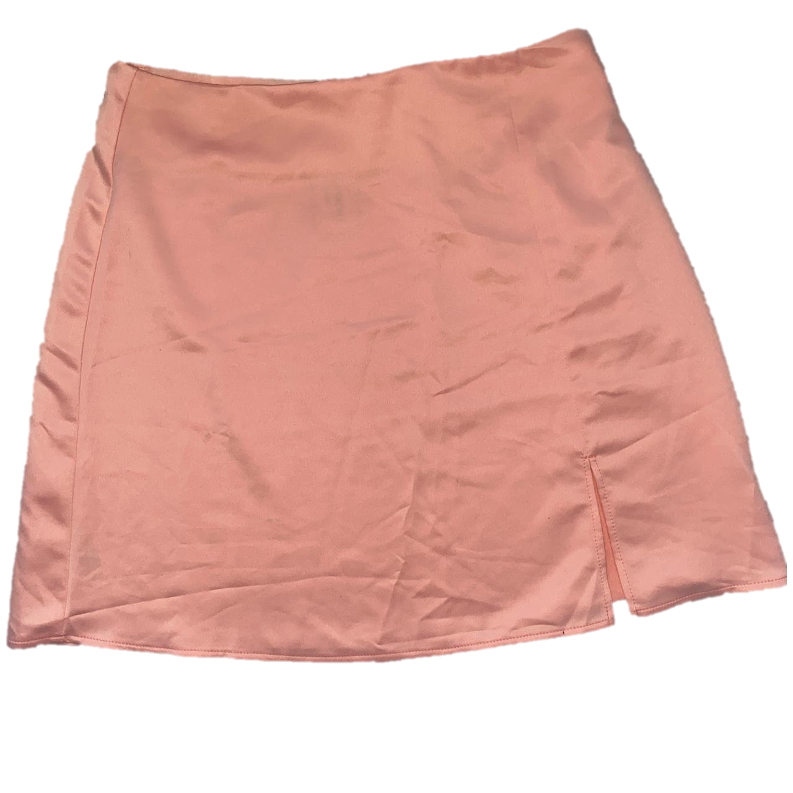



8:42
8:42
8:42
Later
Done
Season
Type
Color
Style
Season
Type
Color
Style
Getting Organized!
Save
Filter
Save
Filter
Spring
Summer
Fall
Import or capture new image
Winter
Title
Description
Default View
Filter Selection
New Rack Modal Form
Champion Crewneck
Tennis Skirt (Pink)
Champion Crewneck
Tennis Skirt (Pink)
Season
#Fall #Tops
#Summer #Bottoms
#Fall #Tops
#Summer #Bottoms
Type
New
Rack Item
Color
Add to Rack!
Champion Crewneck
Tennis Skirt (Pink)
Champion Crewneck
Tennis Skirt (Pink)
#Fall #Tops
#Summer #Bottoms
#Fall #Tops
#Summer #Bottoms
Don’t sweat! Edit your Rack anytime!
Home
My Rack
Build
Home
My Rack
Build

Slide 10
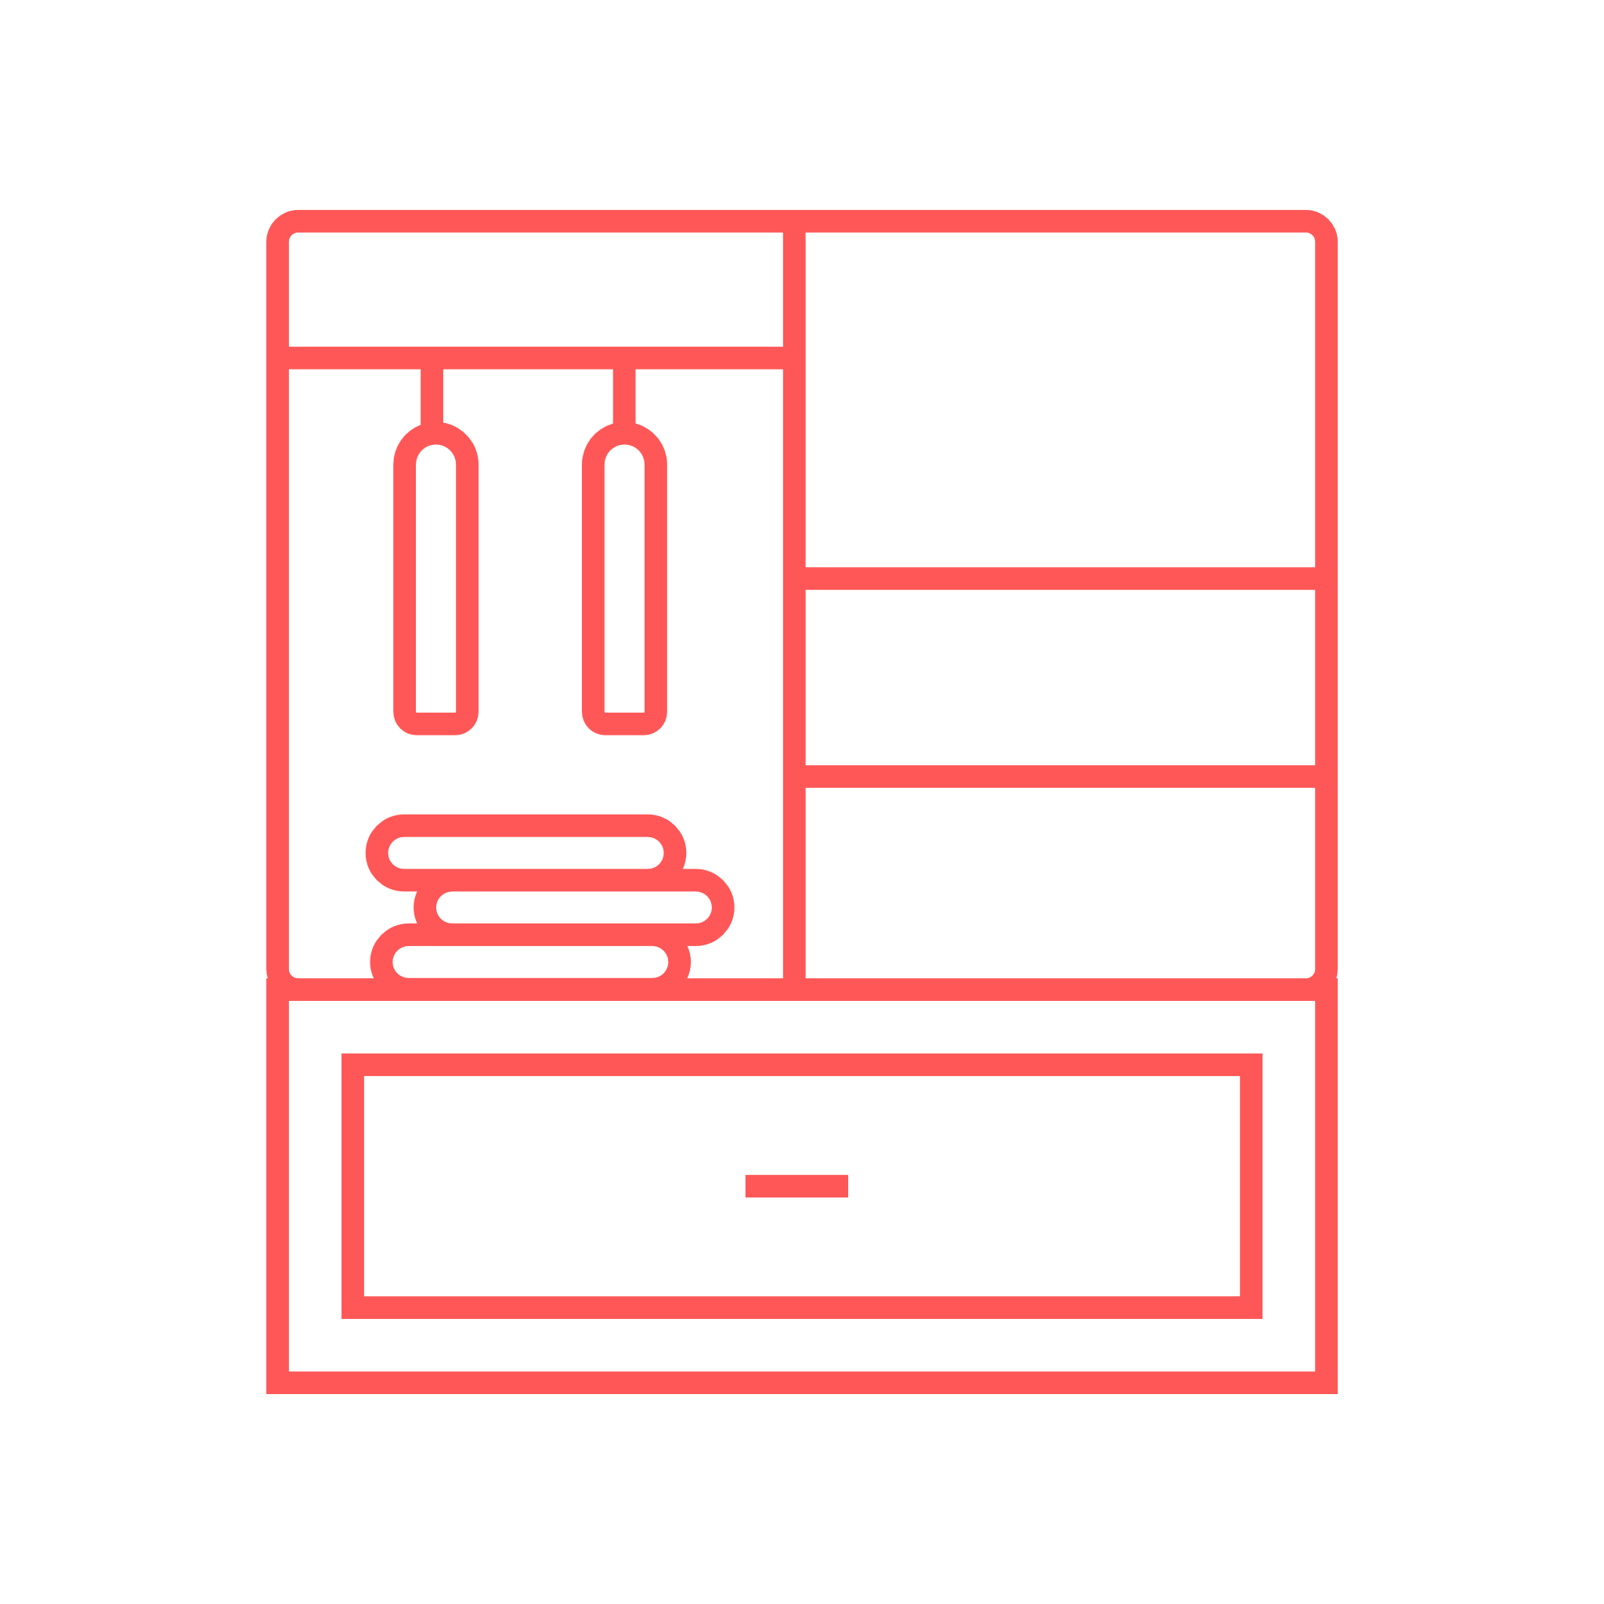
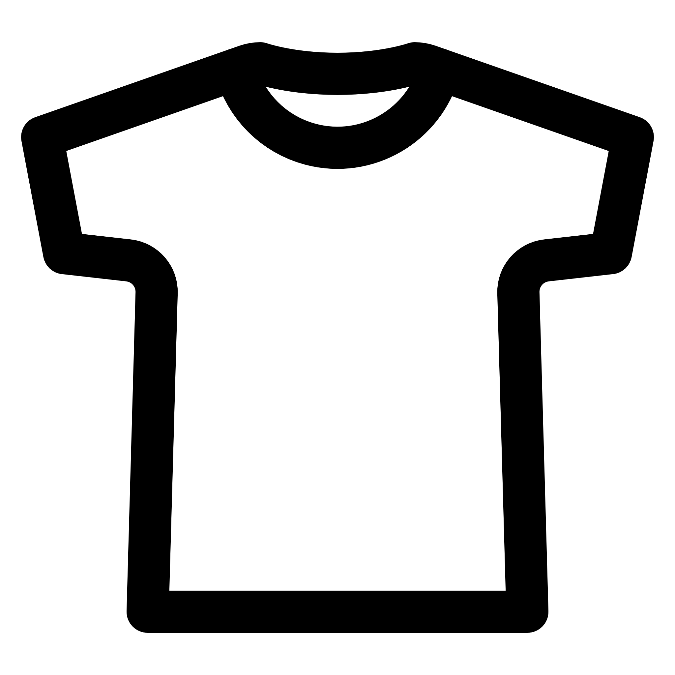
8:42
8:42
8:42
Outfit Builder
Outfit Builder
{{ FirstName }} X RACK Collab
Our Latest Outfit!
{{ FirstName }} X RACK Collab
What shall we create this
{{ TimeOfDay }} ?
{{ FirstName }} X RACK Collab
First Item
Default View
Builder Form
Type?
Select Any
Builder Results
Season?
Select Any
Spring
Champion Crewneck
Tennis Skirt (Pink)
Summer
#Fall #Tops
#Summer #Bottoms
Fall
Add another item
Start
Winter
Rack decides!
Done!
Hope this does the trick!
I think we make a great team! Do you?
Home
My Rack
Build
Home
My Rack
Build
Home
My Rack
Build

Slide 11

Rack Database Schema
MVP
Backburner work
Users
User_id | INT
FirstName | VARCHAR
LastName | VARCHAR
Email | VARCHAR
Password | VARCHAR
Birthday | DATE
Gender | ENUM
Signup_date | DATETIME
User_img
Email_status | ENUM
User_Racks
User_id | INT
Item_id | INT
Item_img
Item_title | VARCHAR
Item_desc | VARCHAR
Season | ENUM
Item_type | ENUM
Color | ENUM
User_Rack_Searches
User_id | INT
Search_id | INT
Season | ENUM
Type | ENUM
Color | ENUM
User_Outfits
User_id | INT
Outfit_id | INT
Generated? | INT SIZE 1
Item_id_1 | INT
Item_id_2 | INT
Item_id_3 | INT
Clothing_Types
Type_id | INT
Type | ENUM

Slide 12
add builder form mockup
add new rack form mockup
add search view

Slide 13
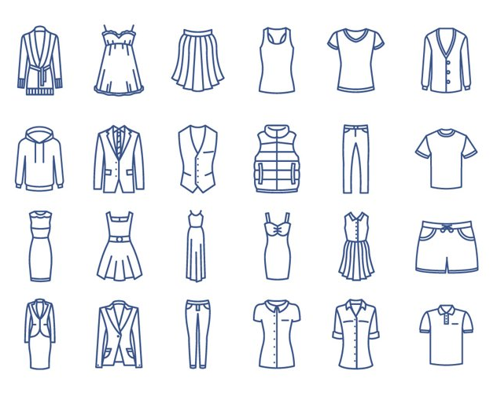
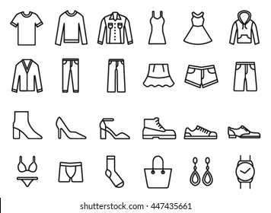

Slide 14
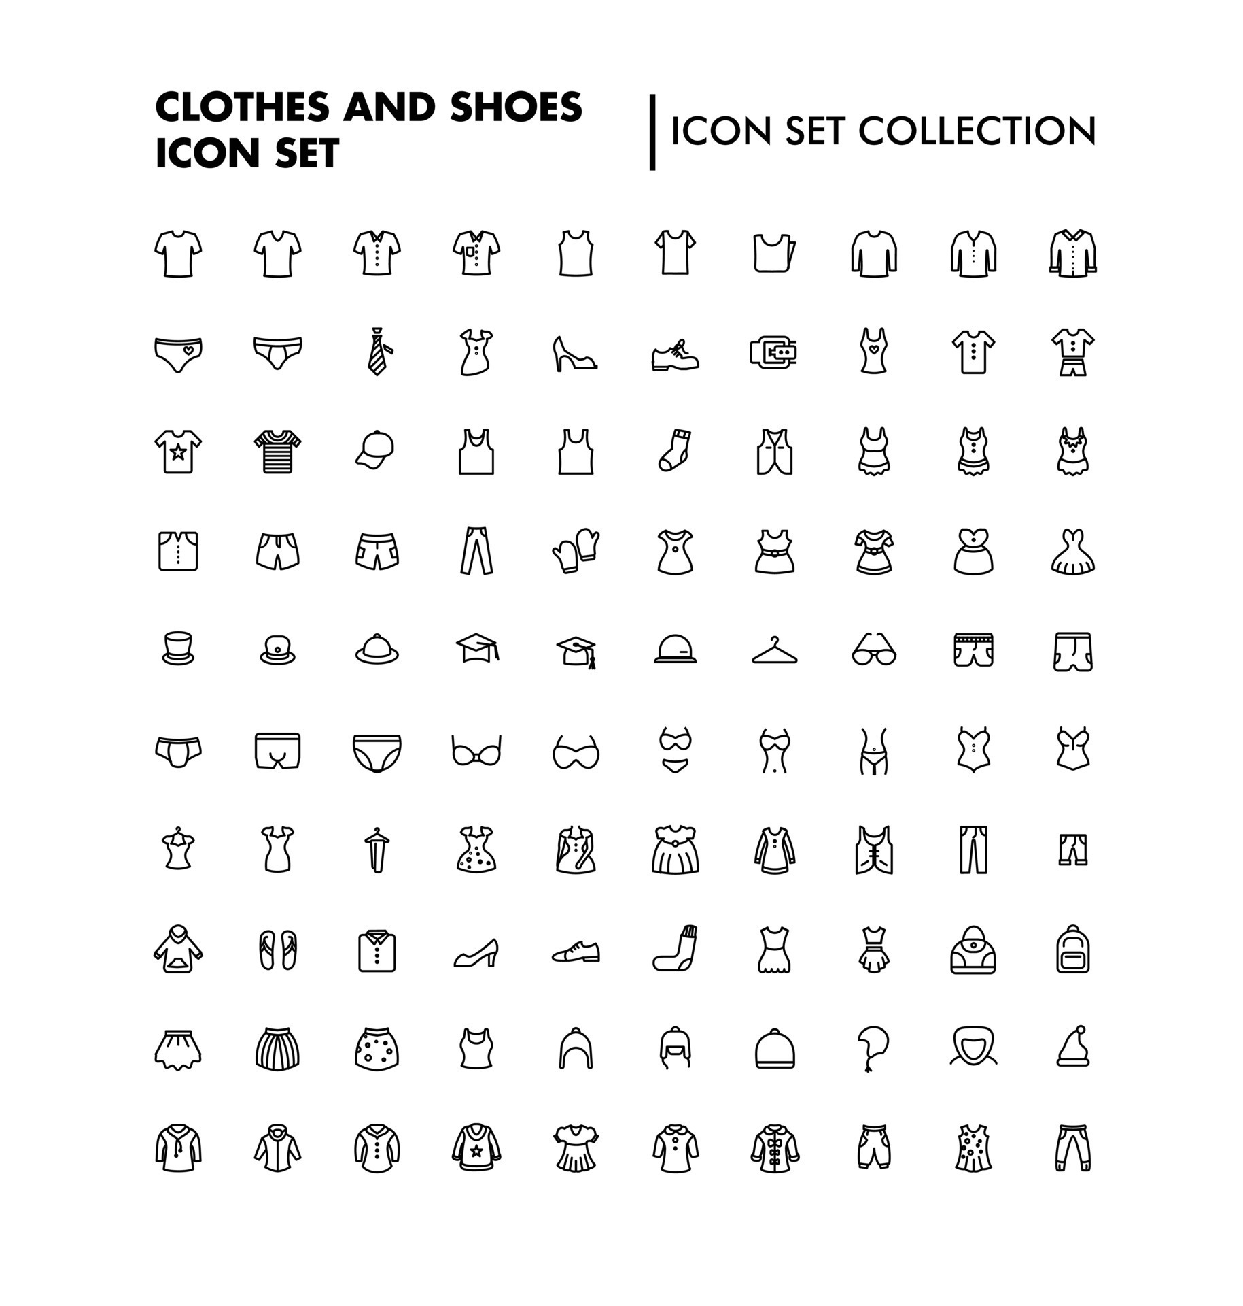

Slide 15
